Slide 1

MAZE SOLVER USING DIJKSTRA’S ALGORITHM
DISCRETE STRUCTURES PROJECT
Utkarsh 2K19/IT/136
Vikas Bhandari 2K19/IT/142

Slide 2
Project Motivation:
Dijkstra’s Algorithm has got applications in many areas including telephone network, finding nearest locations as in google maps(location represents vertices in graph), etc.
So, it becomes important that one develops Dijkstra’s algorithm in order to get intuition of how data structures and algorithms as a whole works and are part of our day to day life.

Slide 3
PROJECT
SOLVING MAZE BY TAKING IMAGE OF THE MAZE FROM USER
USER CAN GENERATE A MAZE USING PYGAME MODULE
AND THEN PROGRAM Will SOLVE USING DIJKSTRA’S ALGO

Slide 4
Project Introduction:
This project will show us the shortest possible path in a maze.
We will also generate our own mazes using randomized dfs.
This project will also make use of data structures like stacks, min-heap priority queue, etc and also uses Dijkstra’s algorithm to find the shortest path.

Slide 5
Algorithms Used:
Randomized Depth First Search/Recursive Back-tracking
For generating mazes we will use randomized DFS Algorithm. We will take a blank image and consider it as a grid of cells. When we choose the first cell it will keep on selecting its neighbors randomly till the end and then it will track back.
2. Dijkstra’s Algorithm
We will use Dijkstra’s Algorithm to find the shortest distance between the starting and ending point in the maze. Once the maze is generated we will consider that maze’s image as a matrix of different pixel values.

Slide 6
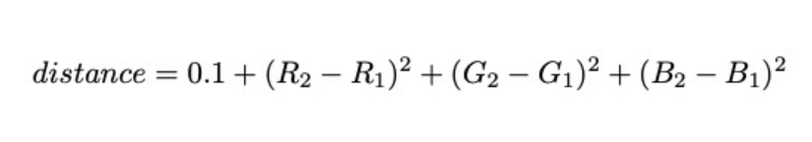
Basic Concept:
We can think of an image of the maze as a matrix of pixels. Each pixel has an RGB value of 0,0,0 (black) or 255,255,255 (white).
Our goal is to create a shortest path which starts in the white and does not cross into the black boundaries. To represent this goal we can treat each pixel as a node and draw edges between neighboring pixels with edge lengths based on RGB value differences.
We will use the Euclidean squared distance formula and add 0.1 to ensure no 0-distance path lengths.
This formula makes the distance of crossing through the maze boundary prohibitively large. The shortest path from source to destination will clearly be around the barrier, not through it.

Slide 7
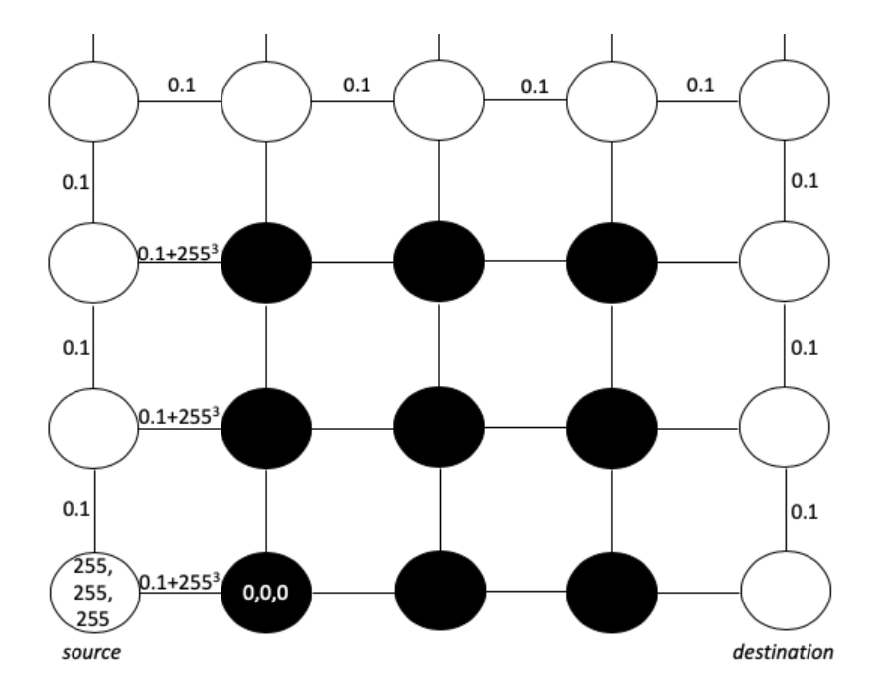

Slide 8
Maze Generation:
In two dimensions, a maze is a series of paths separated by walls, and to simplify the generation one can think of the maze as a 2-dimensional grid.
The grid has a width and height, and each position in the grid can be represented as a cell.
When considered in this manner, the grid can be considered a graph G, in which each cell is a node connected to each of its four neighbors by a wall. The algorithm then finds, based upon a random seed, a spanning of this graph G.

Slide 9
Language Used:
Python
Use of open cv to use the maze as an image, extract pixel values and show the image.
Use of min heap priority queue to keep track of unprocessed nodes.
Several helper functions such as checking the neighboring pixel values, to implement Dijkstra’s algorithm, to calculate the edge length/weights using Euclidean squared distance formula.
Use of pygame for maze generation

Slide 10
What have we implemented so far?
We have implemented the first part of the project i.e the shortest path finder in a maze. We have implemented the algorithm on a random maze image and generated the output.
We are still learning a bit about pygame which will be used in the first part of the project i.e maze generator.

